Slide 1
The VFD’s are Coming! What Dairy Producers Need to Know
Michael D. Apley, Ph.D.
Slivia G. Onetti, Ph.D.
David A. Crass

Slide 2
The VFD Final Rule and Changes Coming on January 1, 2017
Mike Apley

Slide 3
The VFD Final Rule
The new Veterinary Feed Directive rule went into effect October 1, 2015.
The only drugs that come under the VFD rule are drugs for which the label requires a VFD.
Until the end of 2016, this is a very limited number of drugs (Pulmotil® in cattle and swine, Tilmovet® in swine, and Aquaflor® in fish).

Slide 4
Some Confusion
There has been some confusion as to when requirements for a VFD come into effect.
The label of a drug is what makes it a VFD drug.
Drugs with a current VFD label must meet the requirements of the new VFD rule now.
Other drugs will have to meet these requirements based on their new labels, which we anticipate being phased in during December, 2016.

Slide 5
What is a VFD drug?
A "VFD drug” is a drug intended for use in or on animal feed that is limited to use under the professional supervision of a licensed veterinarian.

Slide 6
How can you spot a VFD drug?
Read the label.
All labeling and advertising for VFD drugs, combination VFD drugs, and feeds containing VFD drugs or combination VFD drugs must prominently and conspicuously display the following cautionary statement: "Caution: Federal law restricts medicated feed containing this veterinary feed directive (VFD) drug to use by or on the order of a licensed veterinarian."
Over-the-counter (OTC) drugs do not have this statement.

Slide 7
More VFD Drugs Coming
Because of Guidance for Industry (GFI) documents #209 and #213, all medically important antibiotics used in the feed or water of food animals must be authorized for use by a veterinarian starting January 1, 2017.
In feed – A VFD
In water – a prescription

Slide 8
More VFD Drugs Coming
These medically-important antibiotics are defined in GFI #152, Appendix A. Examples are…
Oxytetracycline (e.g., Terramycin)
Chlortetracycline (e.g., Aureomycin)
Tylosin (e.g., Tylan)
Lincomycin (e.g., Lincocin)
Neomycin (e.g., Neomix)

Slide 9
Drugs that don’t require a VFD
These are drugs that are not “medically important” antibiotics.
Ionophores
Monensin (Rumensin)
Lasalocid (Bovatec)
Laidlomycin (Catalyst)
Decoquinate (Deccox)
Amprolium (Corid)
Bacitracin
Mecadox (Carbadox)

Slide 10
A ‘‘veterinary feed directive’’ is a…
written (nonverbal) statement…
issued by a licensed veterinarian in the course of the veterinarian’s professional practice that…
orders the use of a VFD drug or combination VFD drug in or on an animal feed.”

Slide 11
“This written statement authorizes the client (the owner of the animal or animals or other caretaker) to obtain and use animal feed bearing or containing a VFD drug or combination VFD drug to treat the client’s animals only in accordance with the conditions for use approved, conditionally approved, or indexed by the Food and Drug Administration.”

Slide 12
Definition…
“Conditionally approved” or “indexed” refers to drugs used for minor use or minor species.
This would not apply to our major uses of drugs in the feed or water for cattle, swine, or poultry.

Slide 13
In the new VFD rule…
All VFD drugs are not automatically a category II drug.
“Category II—These drugs require a withdrawal period at the lowest use level for at least one species for which they are approved, or are regulated on a ‘‘no-residue’’ basis or with a zero tolerance because of a carcinogenic concern regardless of whether a withdrawal period is required.”

Slide 14
For a Category II Feed Drug…
The Type A feed (the most concentrated form of the drug, e.g., Aureomycin 50 g) may only be obtained by a licensed feed mill.

Slide 15
“For the purposes of this part, a ‘‘distributor’’ means any person who distributes a medicated feed containing a VFD drug to another person. Such other person may be another distributor or the client-recipient of a VFD”.

Slide 16
“(a) General requirements related to veterinary feed directive (VFD) drugs.
(1) Animal feed bearing or containing a VFD drug or a combination VFD drug (a VFD feed or combination VFD feed) may be fed to animals only by or upon a lawful VFD issued by a licensed veterinarian.
(2) A VFD feed or combination VFD feed must not be fed to animals after the expiration date on the VFD.”

Slide 17
(3) Use and labeling of a VFD drug or a combination VFD drug in feed is limited to the approved, conditionally approved, or indexed conditions of use. Use of feed containing this veterinary feed directive (VFD) drug in a manner other than as directed on the labeling (extralabel use) is not permitted.

Slide 18
“(4) All involved parties (the veterinarian, the distributor, and the client) must retain a copy of the VFD for 2 years. The veterinarian must retain the original VFD in its original form (electronic or hardcopy). The distributor and client copies may be kept as an electronic copy or hardcopy.
(5) All involved parties must make the VFD and any other records specified in this section available for inspection and copying by FDA upon request.”

Slide 19
“(1) In order for a VFD to be lawful, the veterinarian issuing the VFD must:
(i) Be licensed to practice veterinary medicine; and
(ii) Be operating in the course of the veterinarian’s professional practice and in compliance with all applicable veterinary licensing and practice requirements, including issuing the VFD in the context of a veterinarian-client- patient relationship (VCPR) as defined by the State. If applicable VCPR requirements as defined by such State do not include the key elements of a valid VCPR as defined in § 530.3(i) of this chapter, the veterinarian must issue the VFD in the context of a valid VCPR as defined in § 530.3(i) of this chapter.”

Slide 20
“The veterinarian must only issue a VFD that is in compliance with the conditions for use approved,
conditionally approved, or indexed for the VFD drug or combination VFD drug.”
“The number of reorders (refills) authorized, if permitted by the drug approval, conditional approval, or index listing. In cases where reorders (refills) are not specified on the labeling for an approved, conditionally approved, or index listed VFD drug, reorders (refills) are not permitted; “

Slide 21
21 CFR Part 530.3(i)
“(i) A valid veterinarian-client-patient relationship is one in which:
(1) A veterinarian has assumed the responsibility for making medical judgments regarding the health of (an) animal(s) and the need for medical treatment, and the client (the owner of the animal or animals or other caretaker) has agreed to follow the instructions of the veterinarian;
(2) There is sufficient knowledge of the animal(s) by the veterinarian to initiate at least a general or preliminary diagnosis of the medical condition of the animal(s); and”

Slide 22
21 CFR Part 530.3(i)
“(3) The practicing veterinarian is readily available for followup in case of adverse reactions or failure of the regimen of therapy. Such a relationship can exist only when the veterinarian has recently seen and is personally acquainted with the keeping and care of the animal(s) by virtue of examination of the animal(s), and/or by medically appropriate and timely visits to the premises where the animal(s) are kept.”

Slide 23
What will be included in a VFD?

Slide 24
“3) The veterinarian must ensure that the following information is fully and accurately included on the VFD:
(i) The veterinarian’s name, address,and telephone number;
(ii) The client’s name, business or home address, and telephone number;
(iii) The premises at which the animals specified in the VFD are located;
(iv) The date of VFD issuance;”

Slide 25
“(v) The expiration date of the VFD. This date must not extend beyond the expiration date specified in the approval, conditional approval, or index listing, if such date is specified. In cases where the expiration date is not specified in the approval, conditional approval, or index listing, the expiration date of the VFD must not exceed 6 months after the date of issuance;
(vi) The name of the VFD drug(s);
(vii) The species and production class of animals to be fed the VFD feed;”

Slide 26
“(viii) The approximate number of animals to be fed the VFD feed by the expiration date of the VFD. The approximate number of animals is the potential number of animals of the species and production class identified on the VFD that will be fed the VFD feed or combination VFD feed at the specified premises by the expiration date of the VFD;
(ix) The indication for which the VFD is issued;
(x) The level of VFD drug in the VFD feed and duration of use; “

Slide 27
“(xi) The withdrawal time, special instructions, and cautionary statements necessary for use of the drug in conformance with the approval;
(xii) The number of reorders (refills) authorized, if permitted by the drug approval, conditional approval, or index listing. In cases where reorders (refills) are not specified on the labeling for an approved, conditionally approved, or index listed VFD drug, reorders (refills) are not permitted; and
(xv) The veterinarian’s electronic or written signature.”

Slide 28
“(xi) The withdrawal time, special instructions, and cautionary statements necessary for use of the drug in conformance with the approval;
(xii) The number of reorders (refills) authorized, if permitted by the drug approval, conditional approval, or index listing. In cases where reorders (refills) are not specified on the labeling for an approved, conditionally approved, or index listed VFD drug, reorders (refills) are not permitted; and
(xv) The veterinarian’s electronic or written signature.”

Slide 29
The VFD may also contain…
A more speciﬁc description of the location of the animals (for example, by site, pen, barn, stall, tank, or other descriptor the veterinarian deems appropriate);
The approximate age range of the animals
The approximate weight range of the animals; and any other information the veterinarian deems appropriate to identify the animals at issue.

Slide 30
What this means for food animal producers

Slide 31
Procedures for a Feed Containing a Medically Important Antibiotic
A veterinarian may recommend this in response to a disease challenge identified in an ongoing relationship, or…
as we transition to VFD drug labels, this may have been a disease control, prevention, or treatment regimen which had been used over the years and now requires veterinary authorization.

Slide 32
Procedures for a Feed Containing a Medically Important Antibiotic
Be prepared that this is not an automatic authorization, but will initiate a conversation
Non-antibiotic alternatives
Legality (Does it match the label?)
Dose, duration, indication
Need for the use
Efficacy of the proposed antibiotic use in relation to your disease challenge
Ability to meet the withdrawal time prior to slaughter
The veterinarian is also tasked with considering issues of antimicrobial resistance

Slide 33
Procedures for a Feed Containing a Medically Important Antibiotic
A veterinarian can only legally authorize any VFD or prescription drug within the context of a Veterinary-Client-Patient relationship.
The veterinarian will exercise their clinical judgement based on their training and experience within the confines of the law.

Slide 34
Expiration Date vs. Duration
While the VFD expiration date deﬁnes the period of time for which the authorization to feed an animal feed containing a VFD drug is lawful, the duration of use determines the length of time, established as part of the approval, conditional approval, or index listing process, that the animal feed containing the VFD drug is allowed to be fed to the animals.
For example, in swine the currently approved VFD drug tilmicosin has a duration of use of 21 days and an expiration date of 90 days, which means the client has 90 days to obtain the VFD feed and complete the 21 day course of therapy.

Slide 35
Client Responsibilities
Only feed animal feed bearing or containing a VFD drug or a combination VFD drug (a VFD feed or combination VFD feed) to animals based on a VFD issued by a licensed veterinarian;
Not feed a VFD feed or combination VFD feed to animals after the expiration date on the VFD;
Provide a copy of the VFD order to the feed distributor if the issuing veterinarian sends the distributor’s copy of the VFD through you, the client;

Slide 36
Client Responsibilities
Maintain a copy of the VFD order for a minimum of 2 years; and provide VFD orders for inspection and copying by FDA upon request.

Slide 37
Procedures for a Feed Containing a Medically Important Antibiotic
If appropriate, the veterinarian will complete either a written or electronic Veterinary Feed Directive form.
The veterinarian will
keep the original,
provide the client with a copy, and
provide the designated distributor of the medicated feed with a copy

Slide 38
VFD Required?
Milk replacer with neomycin and oxytetracycline
Yes
Chlortetracycline in the feed for footrot
Not allowed, this is illegal extralabel use
Mineral or feed with chlortetracycline for anaplasmosis prevention
Yes, the VFD may only specify label inclusion rates in feed and mineral
Tylosin for reduction in liver abscesses
Yes

Slide 39
VFD Required?
Monensin (Rumensin®) as the only antibiotic in the ration.
No, this is not a medically important antibiotic
Monensin fed concurrently with Tylosin
In this case, the VFD for tylosin would need to authorize the concurrent feeding of monensin
Chlortetracycline or oxytetracycline in the feed for treatment of bovine respiratory disease
Yes

Slide 40
Will I need a new VFD for each pen of cattle in a feedlot or each time I pick up a medicated mineral?
No, as long as…
the number of animals and all other specifications of the VFD are still valid (including expiration date)
The number of animals to be administered the drug are still within the number of animals on the VFD
The duration of feeding of the drug may be completed prior to the expiration date of the VFD, otherwise a new VFD is required.

Slide 41
Water vs. Feed, as of January 1, 2017
All medically important antibiotics used in the feed will require a VFD
There is no legal use of in-feed drugs other than as provided for on the label
All medically important antibiotics used in the water will require a prescription
This prescription may indicate extralabel use of the antibiotic in water if the requirements of the Animal Medicinal Drug Use Clarification Act (AMDUCA) Regulations are met

Slide 42
Veterinarians are…
Actively engaged with the FDA Center for Veterinary Medicine in initiating the VFD process
Continuing to engage in training on the VFD process as well as all aspects of the approved labels for in-feed use of medically important antibiotics
Committed to working with their clients

Slide 43
In the animal health isle at the farm supply store….
What will these products require?
Procaine penicillin G injectable
Aureomycin 4g medicated crumbles
Aureomycin 50 g/lb granular
Long-acting oxytetracycline
Water soluble oxytetracycline
Combination viral vaccine

Slide 44
Type A medicated articles
May be legally obtained without a VFD
If category II, the feed mill must have a license to produce a type B or C feed from the type A medicated article
Some distributors are considering requiring purchasers of Type A medicated articles to sign a document indicating that…
They understand they must have a VFD to feed this product to animals, and…
They will have a valid VFD before feeding this drug to animals.

Slide 45
The producer is going to pulse dose
Basic rules
An animal only appears on a VFD once
The fact that multiple administrations to an animal may occur within the allowed number of animals on a VFD DOES NOT allow for multiple administrations under the same VFD.
If a repeat administration of a VFD drug is indicated, then a new VFD must be provided.

Slide 46
Who is responsible for determining the amount of feed?
The FDA expects the producer and distributor to work together to determine the amount of feed required to feed the specified grams/ton to the approximate number of animals specified on the VFD
In the case of VFD drugs where the dose is specified in mg/lb bodyweight per day, the veterinarian must first determine the g/ton target based on the body weight and anticipated feed consumption.

Slide 47
Who is responsible for keeping track of the amount of feed sold?
The distributor is responsible for keeping track of the amount distributed and that this amount does not exceed the amount authorized by the VFD.

Slide 48
What about a distributor with multiple sites?
One VFD may be written for the distributor as a whole, but the distributor is responsible for maintaining feed delivery records to assure that the amount authorized by the VFD is not exceeded.

Slide 49
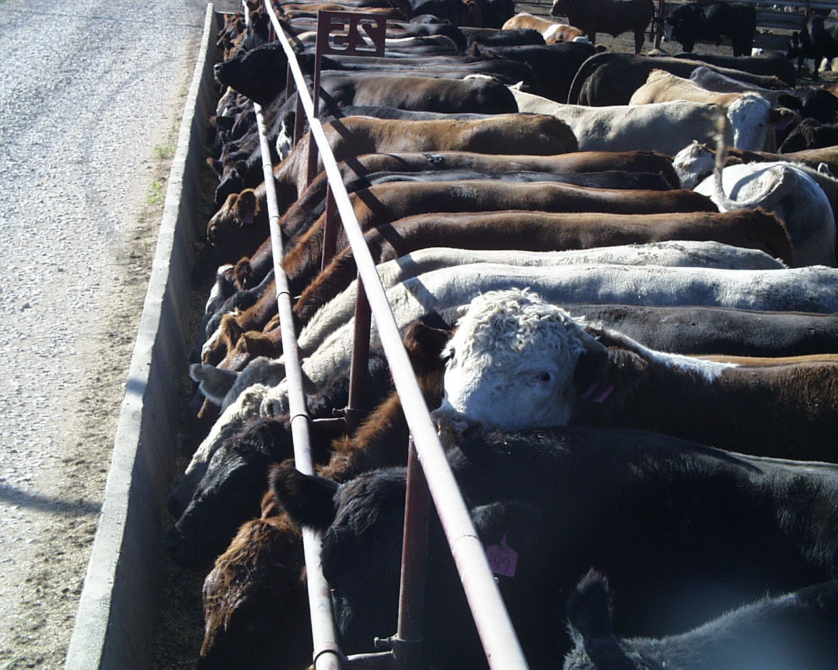

Slide 50
The VFDs are coming – What dairy producers needs to know
VETERINARY FEED DIRECTIVE (VFD)
Silvia Onetti
Vita Plus Corporation

Slide 51
Key principles
VETERINARY FEED DIRECTIVE (VFD)
Limit use of shared class antibiotics to those deemed necessary for therapeutic purposes
No longer growth promotion/feed efficiency claim
Promote involvement of veterinary and nutrition science to establish need
Veterinary Client Patience Relationship

Slide 52
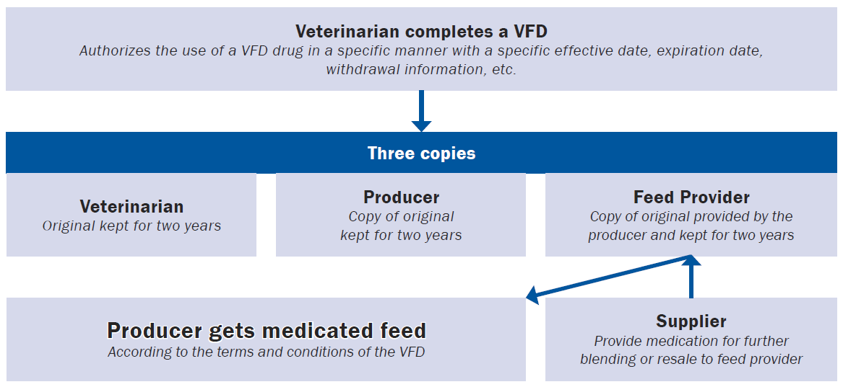
VETERINARY FEED DIRECTIVE (VFD)
The VFD process:
How does it work?

Slide 53
VETERINARY FEED DIRECTIVE (VFD)
Responsibilities of feed provider (distributor)
File one-time notice to FDA of the intent to distribute
Fill a VFD order ONLY if VFD contains all required info
Ensure that feed containing VFD drug(s) complies with the terms of the VFD and is manufactured and labeled in conformity with the approved conditions of use of the drug
Keep records:
Retain VFD orders for 2 yr and make them available for inspection and copying by FDA
Retain records of receipt and distribution of all medicated animal feed containing VFD drugs for 2 yr
Retain records of VFD manufacturing for 1 yr and make them available for inspection and copying by FDA

Slide 54
VETERINARY FEED DIRECTIVE (VFD)
What is a VFD?
A written statement (non-verbal) issued by a licensed veterinarian that authorizes the client (owner or caretaker of animals) to obtain and use a VFD drug (or combination VFD drug) in or on feed in accordance with the conditions of use approved by the FDA.

Slide 55
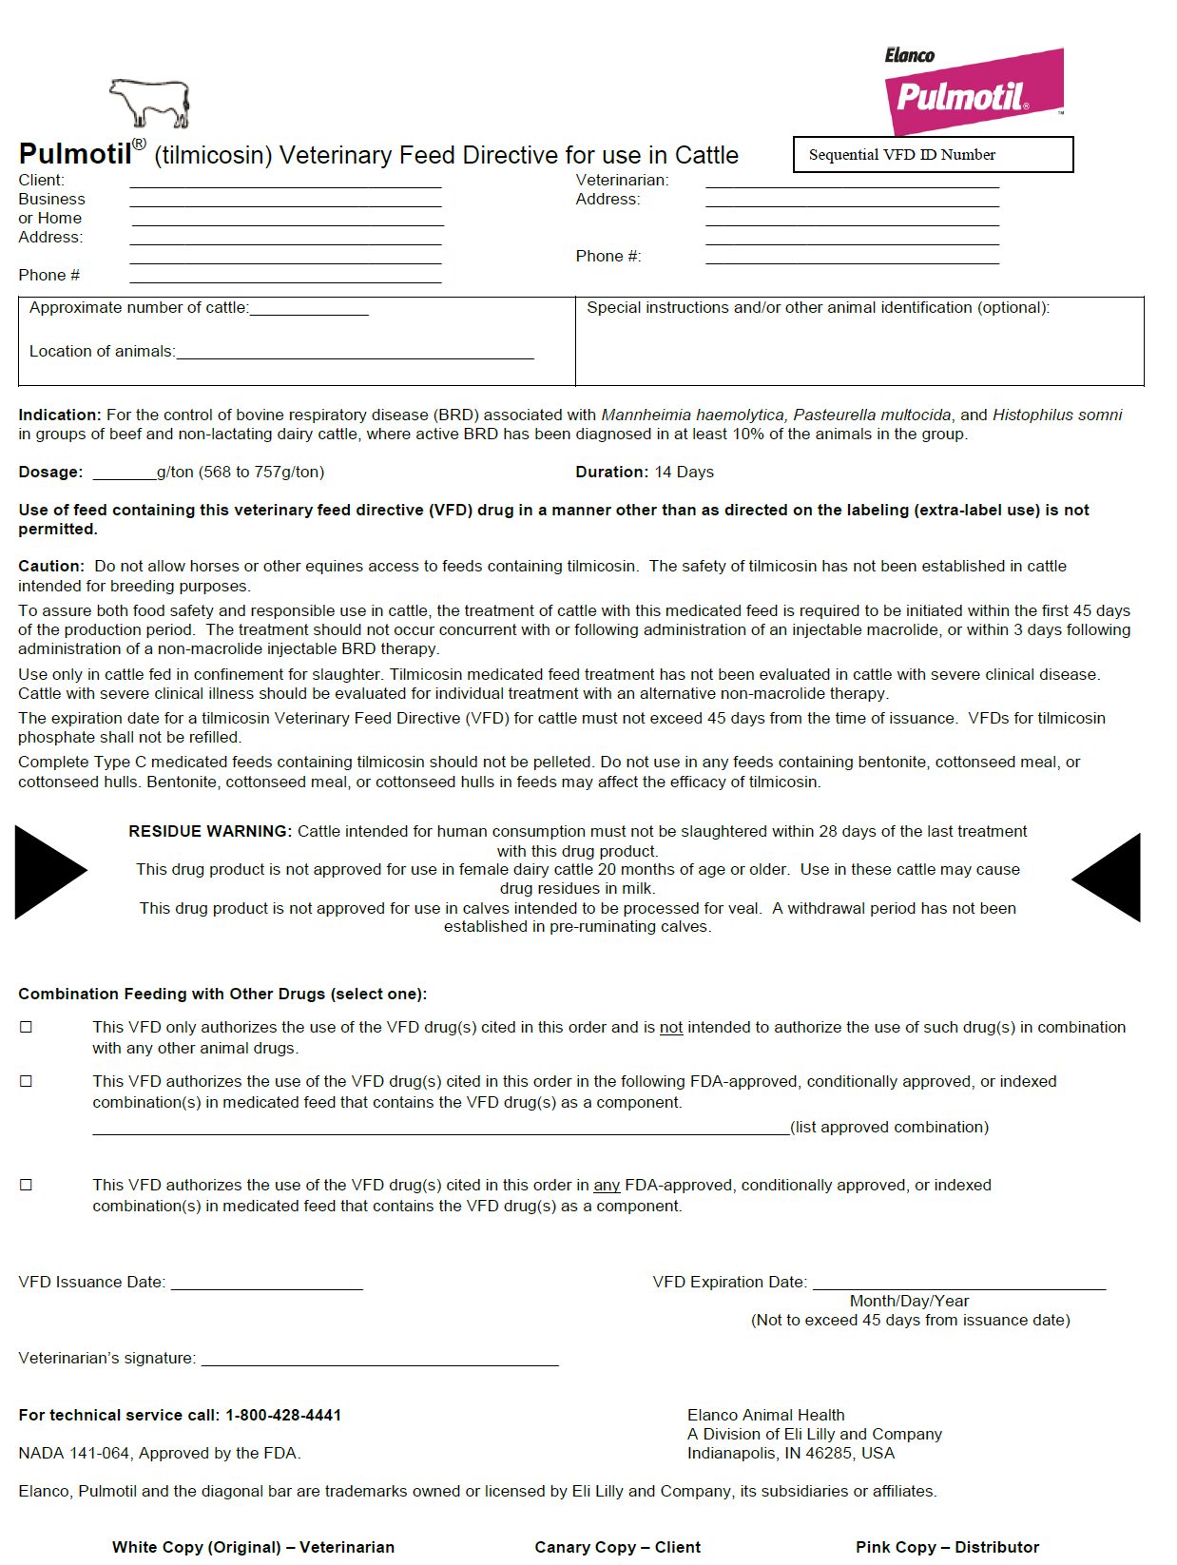
VETERINARY FEED DIRECTIVE (VFD)
What does a
VFD
look like?

Slide 56
VETERINARY FEED DIRECTIVE (VFD)

Slide 57
VETERINARY FEED DIRECTIVE (VFD)
Expiration vs. duration of VFD
The expiration date defines the period of time for which the authorization to feed the VFD feed is lawful
VFD feed cannot be fed (even if in inventory) after the expiration date without having a new VFD issued.
Example: CTC cannot exceed 6 mo after issuance
The duration determines the length of time the VFD feed is allowed to be fed to animals as specified on the product label
Example: CTC at 10 mg/lb bodyweight – not more than 5 d

Slide 58
Practical stuff…VFDs
VETERINARY FEED DIRECTIVE (VFD)
No amount of feed required on the VFD order, however it must contain:
Approximate # of animals to be fed
Level of VFD drug in the feed
Duration of use
Trained nutritionist will calculate the amount of feed needed
The amount of feed authorized under the VFD may be manufactured and shipped in one or multiple loads.
Extra-label use of VFD drugs is not allowed.

Slide 59
Practical stuff…VFDs
VETERINARY FEED DIRECTIVE (VFD)
The distributor that the veterinarian or a client gives the VFD to should be the only distributor filling the entire order.
It is acceptable for a veterinarian to include multiple specified locations for a group of animals provided that the feed is supplied by a single feed manufacturer.
A VFD order can be cancelled contacting all parties involved.
Products used in water containing medically important antibiotics will require a prescription (Rx) issued by a veterinarian

Slide 60
Practical stuff…Producers
VETERINARY FEED DIRECTIVE (VFD)
Establish a veterinarian-client relationship (VCPR)
Plan ahead…
Review all animal health protocols with your veterinarian
Communicate with your feed mill/distributor
Feed VFDs according to label
Only feed the VFD feed to those animals covered under the VFD
Observe expiration dates and duration of use
Keep good records
Take inventory of what and how VFD drugs are currently used
Keep VFD orders for 2 years (provide to FDA upon inspection)
Prevent residues
Have a valid VFD for any VFD feed or drugs being fed on January 1, 2017

Slide 61
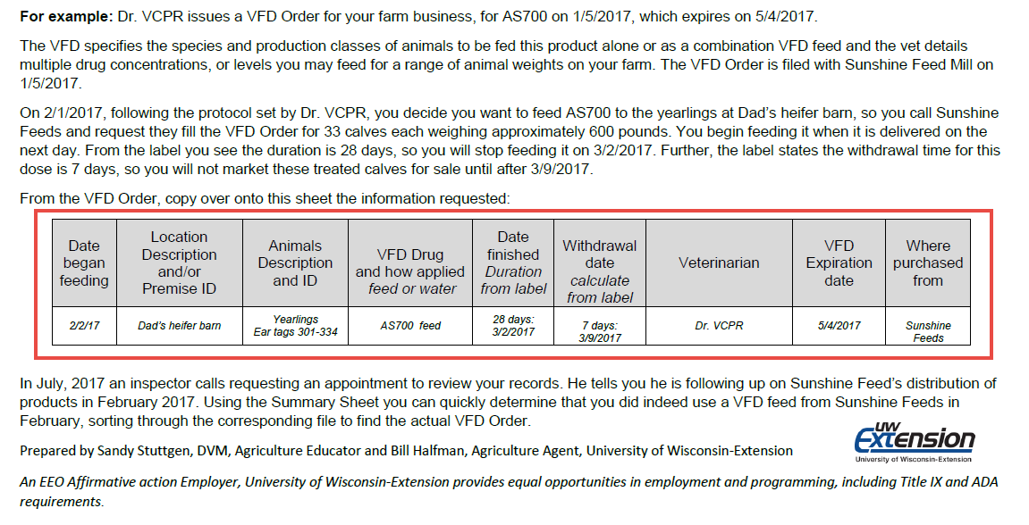
VETERINARY FEED DIRECTIVE (VFD)

Slide 62
Presenters
Michael D. Apley, Ph.D.
Frick Professor of Clinical Sciences, Kansas State University College of Veterinary Medicine
mapley@vet.k-state.edu
Slivia G. Onetti, Ph.D.
Director of Nutrition, Vita Plus Corporation
sonetti@vitaplus.com
David A. Crass
Partner, Michael Best
dacrass@michaelbest.com

